Slide 1
Traffic Flow Analysis Using Power BI
Traffic analysis across multiple junctions using historical data (2015–2017)

Slide 2
Problem Statement
Understanding traffic patterns and predicting congestion to improve traffic management and support better urban planning decisions.

Slide 3
Dataset
Hourly traffic data from 2015 to 2017
Data collected across 4 junctions
Key variables:
DateTime
Vehicles
Junction

Slide 4
Data Preparation
Cleaned missing and null values
Converted DateTime into proper format
Created new time-based columns:
Hour
Day
Month
Ensured consistent data types

Slide 5
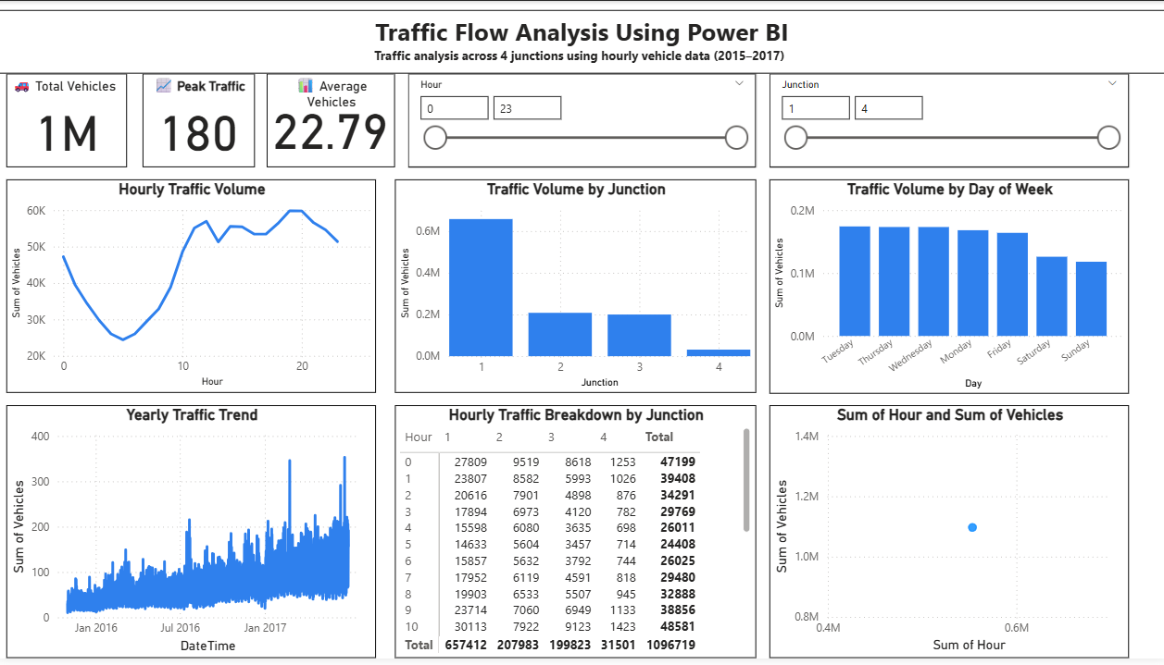
Dashboard Overview
Interactive Power BI dashboard created
Includes:
KPI cards (Total, Peak, Average traffic)
Traffic trend charts
Junction comparison
Heatmap for congestion
Slicers for filtering by date, hour, and junction

Slide 6
Key Insights
Peak traffic observed during daytime hours
Traffic shows a consistent upward trend
Junction 1 has the highest congestion
Traffic patterns are repetitive and predictable

Slide 7
Forecasting
Applied time-series forecasting in Power BI
Used historical data to predict future traffic
Forecast shows increasing traffic trend
Confidence interval (95%) indicates prediction reliability

Slide 8
Solutions
Optimize traffic signal timings during peak hours
Implement congestion control strategies
Improve road infrastructure in high-traffic areas
Use predictive insights for better urban planning

Slide 9
Conclusion
Power BI enables effective traffic analysis through visualization and forecasting. The insights generated can help improve traffic management and support data-driven decision-making for future planning.

